Slide 1
Taming Big Geospatial Data with Hadoop
Dr. Junjun Yin
CyberGIS Center for Advanced Digital and Spatial Studies
Department of Geography and Geographic Information Science
National Center for Supercomputing Applications (NCSA)
University of Illinois at Urbana-Champaign, IL, 61801
jyn@illinois.edu
February 16, 2016

Slide 2
Outline
Big Data
Geospatial Big Data
CyberGIS
Distributed computing environment in ROGER
Apache Hadoop
Apache Spark
Big Data processing in Hadoop Distributed File System (HDFS)
MapReduce in Hadoop (Python) and Spark in Hadoop (Python)
Notes:
Can you give some examples about geospatial Big Data

Slide 3
Outline – details
Big Movement Data
Location Based Social Media Data (e.g. geo-located Tweets)
New York taxi data (demo)
Knowledge discover from movement datasets (e.g. movement flows and hot spots)
CyberGIS
Getting to know CyberGIS
ROGER
Distributed computing environment for Big Data processing
Introduction to Hadoop
MapReduce computing paradigm
Mapper, Reducer and combiner
HDFS (Hadoop File System)

Slide 4
Big Movement Data
In today’s Big Data era, the advancement of positioning technology (e.g. GPS unit) enriches the data with spatial dimensions
Internet of Things
Various types of sensors recording all activities with geo-tags and timestamps
Continuously
Why spatial is special
Geo-located Twitter data (for Twitter user movements)
New York taxi data (for taxi movements)
Challenges
e.g., large volume, messy, noisy
Can traditional GIS (geographical information system) work? (maybe?)
The need for cyberGIS for efficient data management and processing
Notes:
Over 2 million tweets (2 GB) collected for North American per day
400 million for half a year
That is just 1% of all the tweets!
For New York taxi data, basically, Chris has to send several hard drives to the collect the data and it is only for one year already processed data

Slide 5

Visualization and knowledge discovery
Visualization of New York taxi data
The black pixel means the taxi did not have fare and yellows means it did
Source: http://chriswhong.com/open-data/my-first-data-art-nyc-taxi-defrag/
Notes:
Each row represents one taxi, each pixel is one minute and 60 minutes, 12 hours a day.

Slide 6
Illustrations of mapping movements
(a) Polygon based mapping units (ward level) (b) Grid based mapping units (10 km)

Slide 7
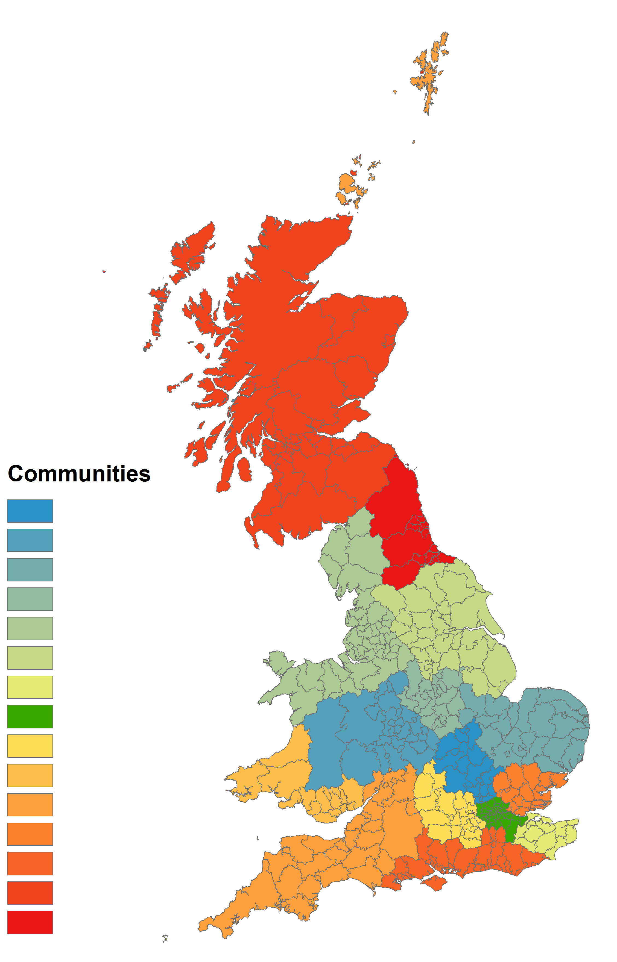
Community detections from mobility patterns
Source: X Liu, L Gong, Y Gong, Y Liu - Journal of Transport Geography, 2015
Community structure of the Great Britain based on the movement of Twitter users

Slide 8
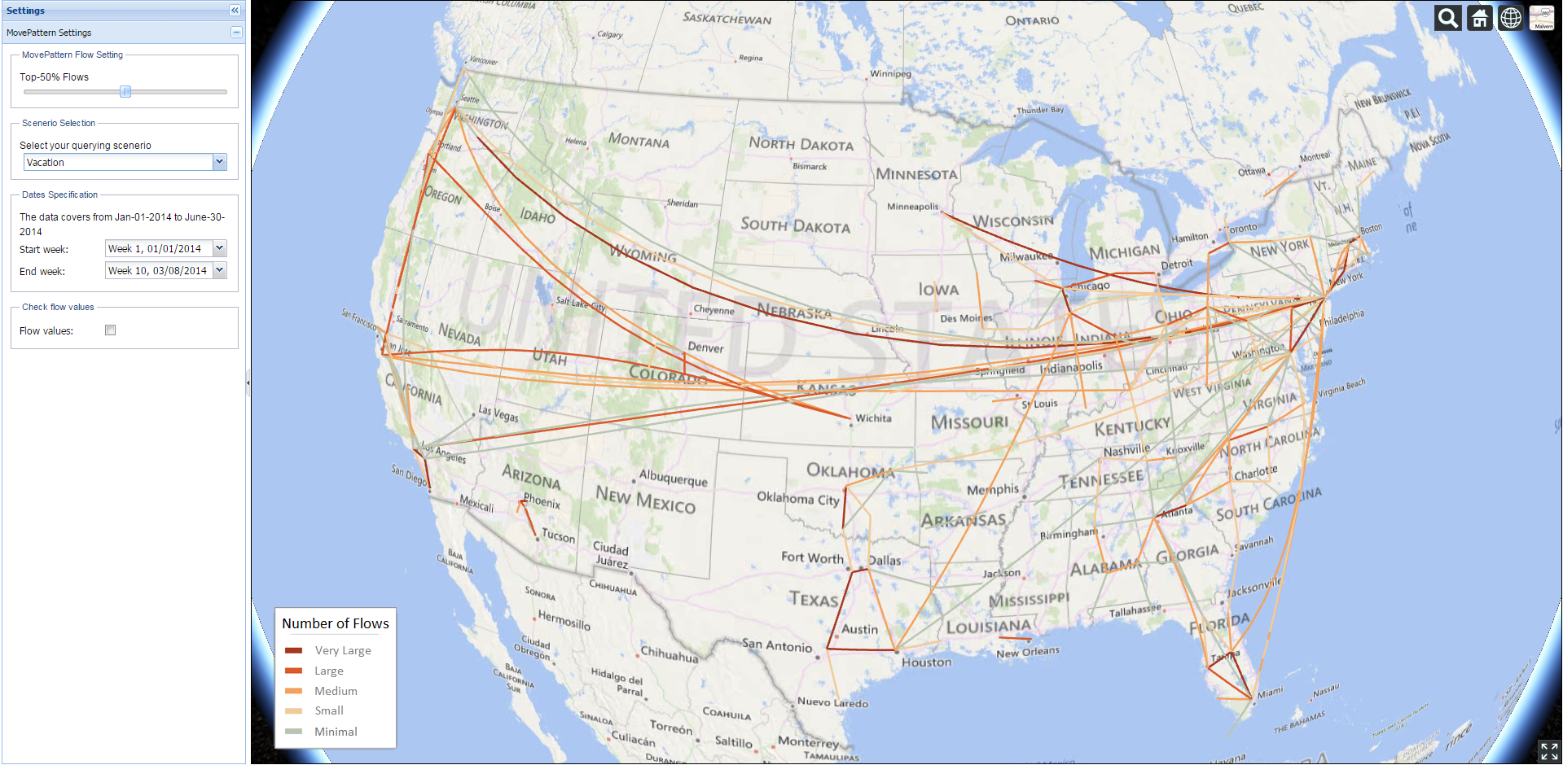
MovePattern
Key-word specified (scenario-based) Twitter user movement patterns
Adjustable (longer) time range selection
Utilizing MapReduce approach with Apache Hadoop for larger volume of data processing
3D virtual globe visualization

Slide 9
Distributed Computing using Hadoop
What is Hadoop
Distributed file system + replicating data in multiple nodes.
Easy-to-use MapReduce interface.
Scalable.
Parallel execution of mappers/reducers.
Fault tolerant.
When to use Hadoop
Data is too big to fit into memory.
Tasks can be decomposed as batch-based processing.
The problem can be modeled by MapReduce computing paradigm.
Scalability is the major issue not interactivity.

Slide 10
Origins of MapReduce and Hadoop
MapReduce is developed in Google
Dean, J. and Ghemawat, S., 2008. MapReduce: simplified data processing on large clusters. Communications of the ACM, 51(1), pp.107-113.
Yahoo developed Hadoop
Shvachko, K., Kuang, H., Radia, S. and Chansler, R., 2010, May. The hadoop distributed file system. In Mass Storage Systems and Technologies (MSST), 2010 IEEE 26th Symposium on (pp. 1-10). IEEE.
Now Hadoop is an open source distributed computing framework, known as Apache Hadoop
http://hadoop.apache.org/

Slide 11
Characteristics of Hadoop
Distributed file system + replicating data in multiple nodes.
Easy-to-use MapReduce interfaces and libraries (e.g., Pig, Java, Hadoop Streaming API)
Scalable.
Parallel execution of mappers/reducers.
Fault tolerant.
Best practice for Hadoop
The problem can be modeled by MapReduce computing paradigm.
Scalability is the major issue not interactivity.

Slide 12
Hadoop in ROGER
Dedicated Hadoop Cluster
Node cg-hm08 – cg-hm18
http://cg-hm08.ncsa.illinois.edu:50070/
How to access
Login to ROGER first
ssh your_netID@roger-login.ncsa.illinois.edu
Login to the master node: cg-hm08
ssh cg-hm08

Slide 13
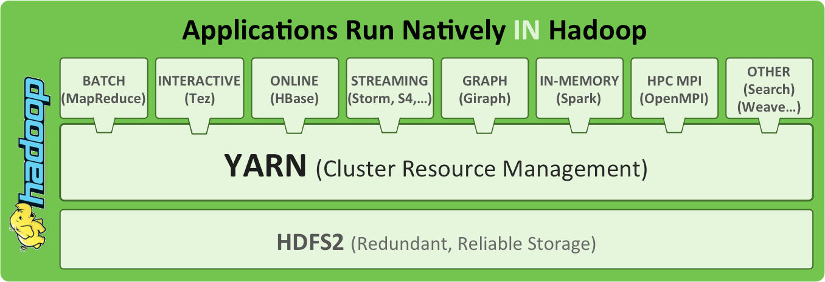
Hadoop Architecture
Source: http://radar.oreilly.com/2014/01/an-introduction-to-hadoop-2-0-understanding-the-new-data-operating-system.html
Notes:
Yahoo developed HDFS to compete with GFS (Google). Google developed MapReduce for their own system.
Yarn for resource management. Queue system.
Hbase – big table, column based database. OS version. SQL-like.
Hive for Hbase
Pig for raw data like loaded CSVs

Slide 14


HDFS
HDFS – Hadoop Distributed File System?
HDFS is the storage mechanism for Hadoop
Designed to scale easily and effectively
Designed to be deployed on low-cost hardware
HDFS components
NameNodes (the master) manage the filesystem namespace
Datanodes (workers) store and retrieve the chunks of data
NameNode
1
2
3
DataNode 1
DataNode 2
DataNode 3
DataNode 4
4
Notes:
Adding more nodes increase both storages space and computing throughput.
Data is too big store in one computer: data is stored on multiple computers.
Very high end machine are expensive: run on commodity hardware
Low-cost hardware will fail- replicate data –
How will the distributed nodes co-ordinate among themselves?
Putting a file into HDFS involves the following steps:
Clients sends a request to the namenode to add a file to HDFS.
Namenode tells client how and where to distribute the blocks.
Client breaks the data into blocks and writes each block to a datanode.
The datanodes replicate the newly-created blocks, based on instructions from the namenode.

Slide 15
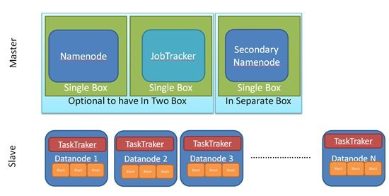
Terminologies
Notes:
The NameNode is the centerpiece of an HDFS file system. It keeps the directory tree of all files in the file system, and tracks where across the cluster the file data is kept. It does not store the data of these files itself.
Optional SecondaryNameNode that can be hosted on a separate machine.
Use the classroom to explain the terminologies

Slide 16
Terminologies
NameNode
manages the file system metadata for HDFS
DataNode
store the actual data
JobTracker
responsible for scheduling the jobs' component tasks on the TaskTrackers, monitoring them and re-executing the failed tasks
TaskTracker
execute the tasks as directed by the JobTracker
NameNode and JobTracker are the masters

Slide 17
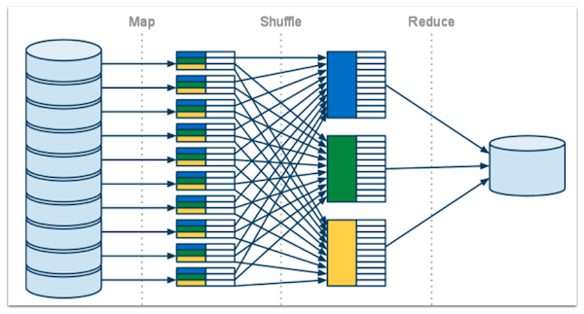
MapReduce computing paradigm
Notes:
Map: filtering and sorting
Reduce: summary

Slide 18
Example: word count in a corpus
Find the frequency of words in a text corpus.
Input: Bag of words =>
“Research”, “Student”, “GIS”, “CIGI”, “Student”, “Geospatial”, “Research”, “Center”, “GIS”, “Research”, “CIGI”, “Research”, “Geospatial”, “GIS”
Output – <Word, Frequency>
Research | 4
Student | 2
CIGI | 2
Center | 1
GIS | 3
Geospatial | 2
Notes:
The concept of <key, value> pairs

Slide 19
Mapper
Key | Value
Research | 1
Student | 1
GIS | 1
CIGI | 1
Student | 1
Geospatial | 1
Research | 1
Research
Student
GIS
CIGI
Student
Geospatial
Research
Mapper
1
Key | Value
Center | 1
GIS | 1
Research | 1
CIGI | 1
Research | 1
Geospatial | 1
GIS | 1
Center
GIS
Research
CIGI
Research
Geospatial
GIS
Mapper
2
Notes:
Point weights as an option, applying values, perhaps by category or spatial bounding box.

Slide 20
Shuffle
CIGI | 1
CIGI | 1
Key | Value
Research | 1
Student | 1
GIS | 1
CIGI | 1
Student | 1
Geospatial | 1
Research | 1
Geospatial | 1
Geospatial | 1
GIS | 1
GIS | 1
GIS | 1
Research | 1
Research | 1
Research | 1
Research | 1
Key | Value
Center | 1
GIS | 1
Research | 1
CIGI | 1
Research | 1
Geospatial | 1
GIS | 1
Student | 1
Student | 1
Center | 1

Slide 21
Reducer
Key | Value
CIGI | 2
CIGI | 1
CIGI | 1
Geospatial | 1
Geospatial | 1
Key | Value
Geospatial | 2
GIS | 1
GIS | 1
GIS | 1
Key | Value
GIS | 3
Research | 1
Research | 1
Research | 1
Research | 1
Key | Value
Research | 4
Key | Value
Student | 2
Student | 1
Student | 1
Key | Value
Center | 1
Center | 1
Notes:
Summary.

Slide 22
Combiner
Key | Value
Research | 1
Student | 1
GIS | 1
CIGI | 1
Student | 1
Geospatial | 1
Research | 1
Key | Value
Research | 2
Student | 2
GIS | 1
CIGI | 1
Geospatial | 1
Mapper
Output
Key | Value
Center | 1
GIS | 1
Research | 1
CIGI | 1
Research | 1
Geospatial | 1
GIS | 1
Key | Value
Center | 1
GIS | 2
Research | 2
CIGI | 1
Geospatial | 1
Notes:
Run in the memory of the mapper.

Slide 23
Reducer + Combiner
Key | Value
CIGI | 2
CIGI | 1
CIGI | 1
Geospatial | 1
Geospatial | 1
Key | Value
Geospatial | 2
GIS | 1
GIS | 2
Key | Value
GIS | 3
Research | 2
Research | 2
Key | Value
Research | 4
Key | Value
Student | 2
Student | 2
Key | Value
Center | 1
Center | 1

Slide 24
Basic Hadoop Commands
Check Hadoop directory
hdfs dfs –ls [/user/netID/folder]
hdfs dfs –ls folder
Make a Hadoop directory
hdfs dfs –mkdir folder
Copy data into HDFS
hdfs dfs –copyFromLocal local_file [path_in_HDFS]
Copy data from HDFS to local directory
hdfs dfs –getmerge file_in_HDFS path_in_local_directory
Delete files from HDFS
hdfs dfs –rm –r file_in_HDFS

Slide 25
Example using Hadoop Streaming API
Summarize the frequency of words occurred in the constitution of United States of America
Code and data are stored in /gpfs_scratch/geog479/lecture5
Copy the folder to your home directory
cp –r /gpfs_scratch/geog479/lecture5 ~/
cd lecture5/word_count_hadoop_python
hdfs dfs –copyFromLocal const.txt
hadoop jar /usr/hdp/2.3.2.0-2602/hadoop-mapreduce/hadoop-streaming-2.7.1.2.3.2.0-2602.jar -file mapper.py -mapper mapper.py -file reducer.py -reducer reducer.py -input const.txt -output word_count.txt

Slide 26
Example in Spark
launch spark:
ssh cg-hm08
module load java
pyspark
text_file = sc.textFile("const.txt")
counts = text_file.flatMap(lambda line: line.replace(",", "").replace(".", "").split(" ")).map(lambda word: (word, 1)).reduceByKey(lambda a, b: a + b)
#counts.saveAsTextFile("hdfs://...") (this saves to HDFS format, we will not use it this time)
results = counts.collect()
print results
type exit() to exit Spark shell

Slide 27
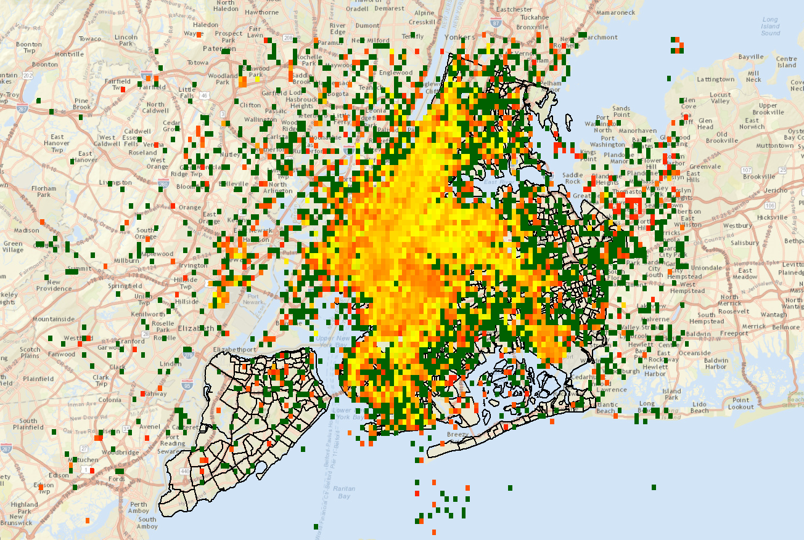
New York taxi pickup passenger density map

Slide 28
Taxi Data
January 2013 Taxi Trips from FOIA (Freedom of Information Act) request from Chris Whong
(http://www.andresmh.com/nyctaxitrips/)
Trip:
medallion, hack_license, vendor_id, rate_code, store_and_fwd_flag, pickup_datetime, dropoff_datetime, passenger_count, trip_time_in_secs, trip_distance, pickup_longitude, pickup_latitude, dropoff_longitude, dropoff_latitude Fare:
medallion, hack_license, vendor_id, pickup_datetime, payment_type, fare_amount,surcharge, mta_tax, tip_amount, tolls_amount, total_amount
Notes:
Explain code

Slide 29
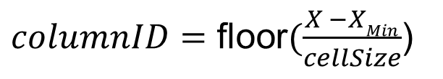
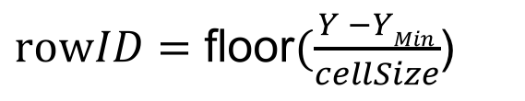
Find the cell number (index) that a point belongs to:
(X_{Min}, Y_{Max})
(xMax, Y_{Max})
[6,0]
[5,0]
[4,0]
[3,0]
[2,0] | [2,1] | [2,2]
[1,0] | [1,1] | [1,2]
[0,0] | [0,1] | [0,2] | [0,3] | [0,4] | [0,5]
$columnID=\text{floor}(\frac{X −XMin}{cellSize}$)
$rowID=\text{floor}(\frac{Y −YMin}{cellSize}$)
(X_{Min}, Y_{Min})
(X_{Max}, Y_{Min})

Slide 30
Quiz
The client program that is uploading the data into HDFS performs I/O directly with the ( ).
The ( ) only stores the metadata of the file system, but is not responsible for storing or transferring the data.
A MapRedue job consists of three main phases: ( ), ( ), and ( )
True or False: Files are write-once only (not updateable)
Notes:
Putting a file into HDFS involves the following steps:

Slide 31
Apache Pig
This unit includes the following topics:
What is Pig?
Pig Script and Grunt Shell
Pig Data Model
Pig Latin and Relation Names
Use Pig to navigate through HDFS and explore a dataset
Notes:
Pig was created at Yahoo. To make it easier to analyze the data in your HDFS without the complexities of writing a traditional Mapreduce program.
Pig abstract away these complexities.
Internally it creates a sequence of MapReduce jobs,

Slide 32
What is Pig?
Pig provides an engine for executing data flows in parallel on Hadoop¹.
A scripting platform for processing and analyzing large data sets
Apache Pig allows Apache Hadoop users to write complex MapReduce transformations using a simple scripting language called Pig Latin.
Pig Latin includes operators for many of the traditional data operations (join, sort, filter, etc.), as well as the ability for users to develop their own functions for reading, processing, and writing data.
How Pig differs from MapReduce?
It can do early error checking (did the user try to add a string field to an integer field?) and optimizations (can these two grouping operations be combined?).
Pig Latin cost less to write and maintain than Java code for MapReduce.
Multiple operators are provided.
1. Gates, A. (2011). Programming Pig. " O'Reilly Media, Inc.".
Notes:
I am a pig. I let you play with the data from HDFS cages. I speak Pig Latin.
It includes a language, Pig Latin, for expressing these data flows.
Pig uses a high-level, SQL-like programming language named Pig Latin.
Multiple operators, particularly join, are not provided and must instead be written by the user.

Slide 33
Apache Pig Philosophy
The Apache Pig Project published founding philosophy for pig developers¹.
Pigs Eat Anything
Pig can process any data, structured or unstructured.
Pigs Live Anywhere
Pig is not just for Hadoop. Pig can run on any parallel data processing framework.
Pigs Are Domestic Animals
Pig is designed to be easily controlled and modified by its users.
Pigs Fly
Pig processes data quickly.
1. http://pig.apache.org/philosophy.html
Notes:
Pig can process unstructured data without a schema.
Pig is intended to be a language for parallel data processing. First implemented on Hadoop
Pig provide user defined functions.

Slide 34
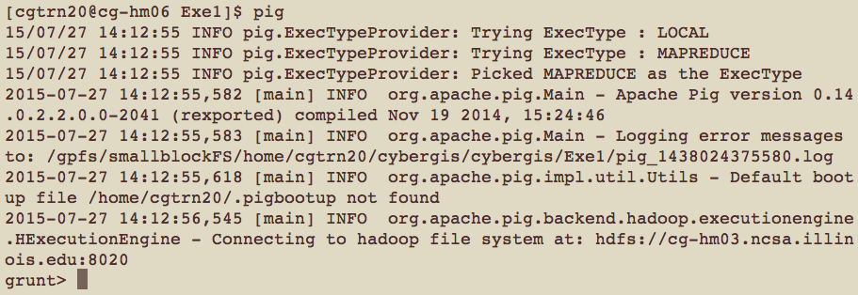
Pig Script and Grunt Shell
Pig Latin scripts can be executed by Pig script or Grunt shell
Pig script
Write a Pig Latin program in a text file and execute it using the pig command
Grunt shell
Grunt is Pig’s interactive shell. It enables users to enter Pig Latin interactively and provides a shell for users to interact with HDFS.
Notes:
To enter Grunt, invoke Pig with no script or command to run. Typing: pig

Slide 35
Pig’s Data Model
Pig’s data types are consisted of two categories:
Scalar types contain a single value
Complex types contain other types.
Scalar Types
Int, long, float, double, chararray (strings of Unicode characters), bytearray (a blob), boolean
Complex types
Map: Collection of key value pairs
[name#David,department#CyberGis,zip#61821]
Tuple: Ordered set of fields
(David,CyberGIS,61821) – Tuples are divided into fields.
Bag: Unordered collection of tuples
{(David,CyberGIS,61821), (Tom,Mathmatics,61820),
(Clair,Computer Science,61821) }
Notes:
Int: a 32-bit signed integer
Long: a 64-bit signed integer
Float: 32 bit floating-point number
Double:64 bit floating-point number

Slide 36
Pig Latin 1
Pig Latin is a dataflow language.
Each processing step results in a new data set, or relation.
input= LOAD ‘twitterdata.txt' USING PigStorage(',')
In input = LOAD ’ twitterdata.txt ', input is the name of the dataset in HDFS.
Case sensitive
Pig Latin cannot decide whether it is case-sensitive.
Keywords in Pig Latin are not case-sensitive (e.g., LOAD is identical to load)
Comments
SQL-style single-line comments (--) and Java-style multiline comments (/* */).
Pig Latin Reference Manual
http://pig.apache.org/docs/r0.7.0/piglatin_ref2.html

Slide 37
Pig Latin 2
LOAD
raw = LOAD 'cybergis/radiation.csv' USING PigStorage(',') AS (CapturedTime : chararray,Latitude:double,Longitude:double,Value:int,Unit:chararray);
Pig is very lenient in terms of schemas:
If you define a schema, then Pig will perform error-checking with it.
If you do not define a schema, Pig will make a best guess as to how the data should be treated
STORE
STORE result into 'heatmap_output';
The store command sends the output to a folder in HDFS.
DUMP
DUMP result;
The dump command directs the output of your script to your screen.
Notes:
Next, I would like to talk about frequently used operators.
Load/Store functions
Diagnostic operators
Dump is particularly useful during debugging and prototyping sessions.

Slide 38
Pig Latin 3
FILTER
step1 = FILTER step0 BY $4 MATCHES 'cpm’;
Use FILTER to select the rows you want or filter out the rows you do not want.
Select the rows by its fifth field (i.e., $4).
FOREACH…GENERATE
step4 = FOREACH step3 GENERATE $CapturedTime,$3,$4;
The FOREACH operator transforms your data into different data sets.
The FOREACH takes a set of expressions and applies them to every record in the data pipeline,
GROUP
step5_group = GROUP step5 BY (latkey,logkey);
The group statement collects together records with the same key.
LIMIT
L = LIMIT step5_group 10;
See only a limited number of results.
Notes:
Relational Operators

Slide 39
Preparing the data using Pig
PIG is a higher level, SQL-like programming language for Hadoop jobs.
Easier code for simple (and even some advanced) Hadoop jobs.
On a compute cluster, it will be around the same speed as the Java MapReduce code
In this demonstration, we will only use one day data (1st February, 2014)
ssh net_ID@roger-login.ncsa.Illinois.edu
ssh cg-hm08
cd ~/lecture5/pig
hdfs dfs –copyFromLocal day1.txt [user/file_name]
The Pig script is located in:
cd ~/lecture5/pig
pig -f filter_usa.pig -param input=day1.txt

Slide 40
An example geo-located Twitter message
“user_id”Some little bug has bitten me in the night and my knee is the size of a melon at present.. Not the best of starts to my day! #antihystermine51.3432617,1.4025932<a href="http://twitter.com/download/android" rel="nofollow">Twitter for Android</a>false1Tue Jul 01 23:40:46 CDT 2014-1en166145388http://abs.twimg.com/images/themes/theme10/bg.gifLe5leyH25b176c519f167e6BroadstairsBroadstairsUnited Kingdomneighborhoodnull(51.326601,1.3832097),(51.377546,1.3832097),(51.377546,1.449228),(51.326601,1.449228),Polygonhttps://api.twitter.com/1.1/geo/id/25b176c519f167e6.jsonLesley HopperRamsgate. Kent. England2082203759Tue Jul 13 07:55:49 CDT 2010
User_ID, latitude1, longitude1, timestamp1
User_ID, latitude2, longitude2, timestamp2
Trajectory: User_ID, <location1, timestamp1>, <location 2, timestamp2>, …

Slide 41
Pig script
raw = LOAD '${input}' USING PigStorage('\u0001') AS (tweetId,text:chararray,geo,source,isretweet,search_id,create_at,meta_data,to_user_id,language_code,user_id,profile_image_url,user_name,place_id,place_name,place_fullname,country,place_type,street_address,boundary,boundary_type,place_url);
clean = DISTINCT raw;
step0 = FILTER clean BY geo is not null AND geo != 'null' AND geo != '' AND isretweet == 'false' AND create_at is not null AND create_at != 'null' AND create_at != '';
step1 = FOREACH step0 GENERATE user_id, flatten(STRSPLIT(geo, ',')), To_ISO(Get_Time(REPLACE(REPLACE(create_at, 'CDT', '-05:00'), 'CST', '-06:00'), 'EEE MMM dd HH:mm:ss Z yyyy')) , text;
-- $2 is longitude, $1 is latitude
step2 = FILTER step1 BY $2 > -167.276413 AND $2 < -56.347517 AND $1 > 5.499550 AND $1 < 82.296478;
step3 = FOREACH step2 GENERATE $0, $1, $2, $3;
STORE step3 INTO '${input}_filtered.txt' USING PigStorage(',');

Slide 42
Preparing the data using Pig
We will revisit the script and practice in this week’s lab

